Slide 1
Online Food Delivery
Title: QuickBite – A Digital Food Delivery Solution Subtitle: Bringing Restaurants & Customers Closer Tagline: "One Tap, Countless Flavors" By: Team QuickBite / [Your Name] Date: [Insert Date]

Slide 2
Project Vision
Developed a user-friendly online food delivery platform for seamless browsing and ordering of meals from local restaurants.
Implemented smart filtering options for users to discover food based on cuisine, dietary preferences, and budget.
Designed an intuitive user interface to enhance the overall customer experience.
Built an admin panel that allows easy management of restaurant listings, menu updates, and order tracking.
Enabled real-time order tracking so users can monitor the status of their deliveries.
Integrated secure payment processing to ensure safe and trustworthy transactions.
Focused on delivering a reliable and efficient platform that meets the needs of both users and administrators.

Slide 3
Tech Stack
Frontend: Bootstrap 5, JavaScript, AJAX for dynamic updates
Backend: ASP.NET (C#), .NET Framework 4.8
Database: SQL Server (LocalDB .mdf file)
Tools: Visual Studio, Git, SSMS

Slide 4
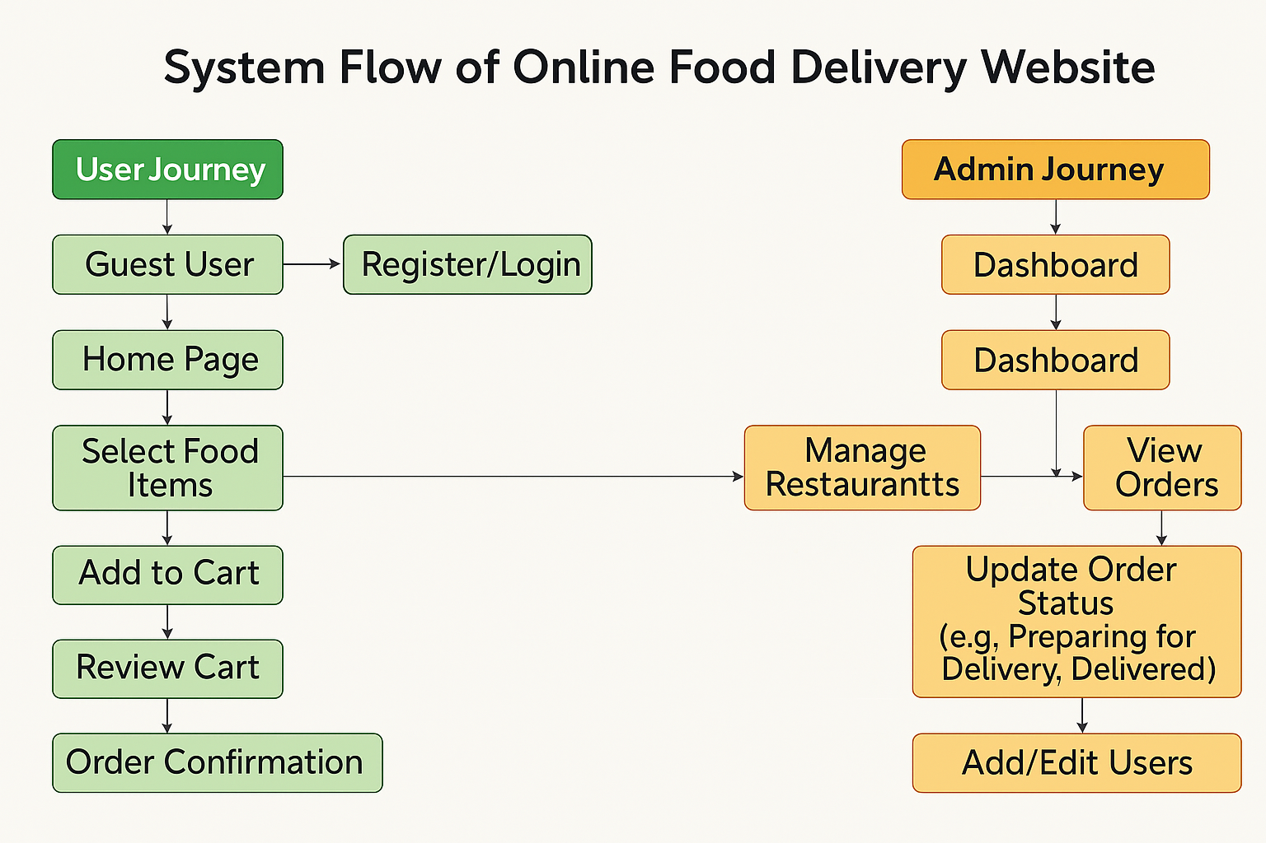

Slide 5
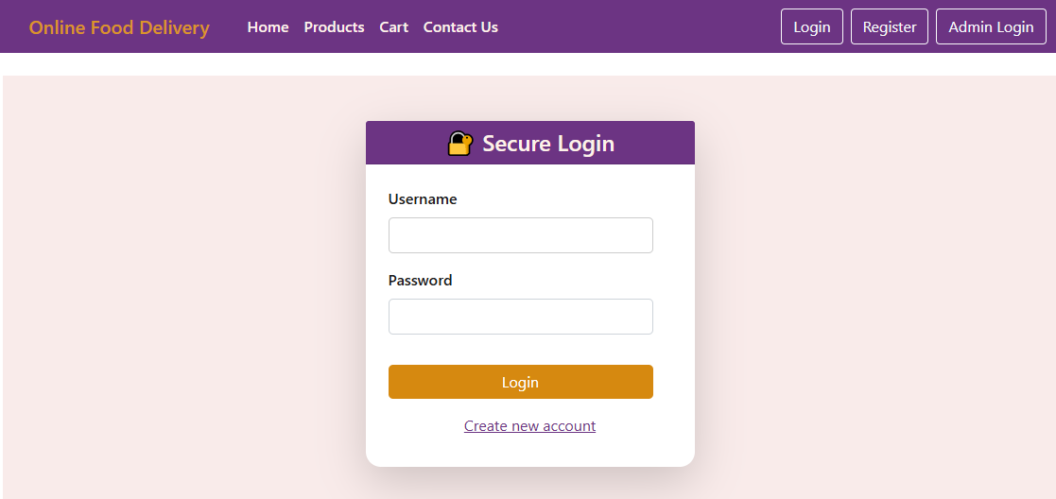
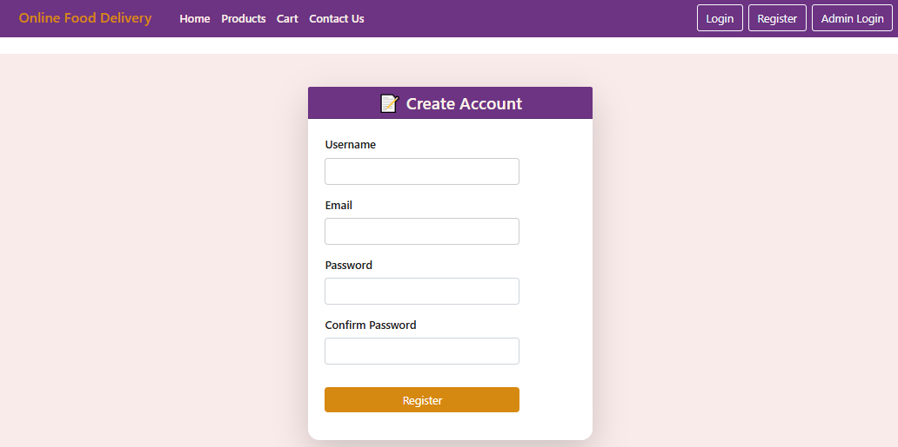
Login/Signup Pages
Login Page: Allows existing users to log in by validating their credentials against the database. Upon successful login, the user is redirected to the Home page.
Signup Page: Enables new users to create an account by submitting their details, including allergies and address, which will be used for providing personalized suggestions. The submitted information is stored in the database.
Functionality:
When the user clicks "Login", the system verifies the credentials with the database.
When the user clicks "Create Account", the system validates the form and stores the new user data in the database.

Slide 6
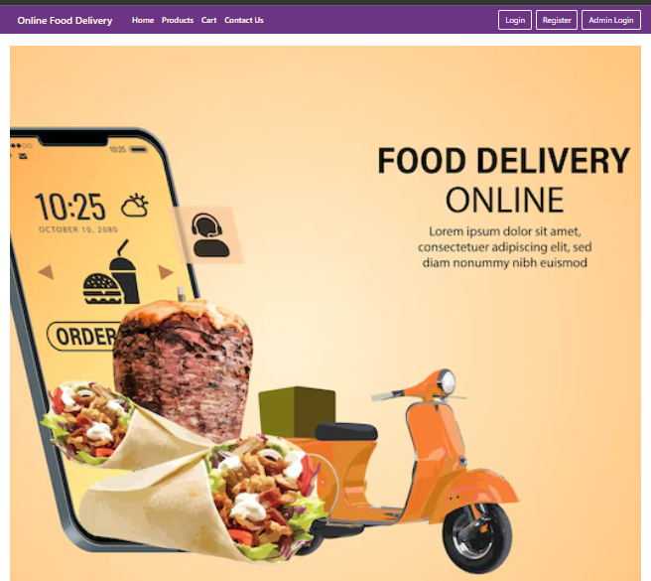
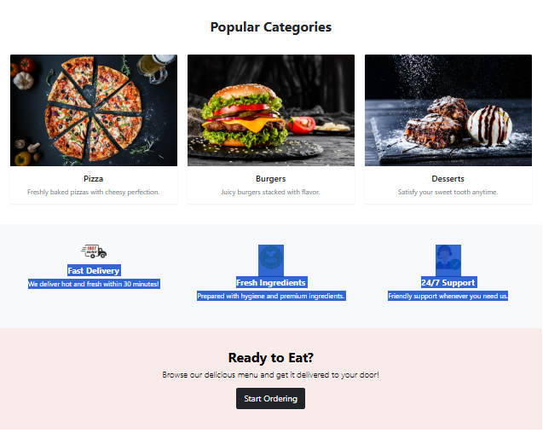
Home Page – Discover Deliciousness
We offer a seamless online food delivery service, bringing restaurant-quality meals right to your doorstep. Our platform is designed for convenience, speed, and satisfaction—whether you're craving cheesy pizzas, juicy burgers, or mouthwatering desserts.
Our homepage showcases this experience with vibrant visuals and engaging content that highlights what we offer:
Fast delivery in just 30 minutes
Meals made from fresh, premium ingredients
Round-the-clock customer support for any assistance
A smooth and user-friendly ordering process

Slide 7
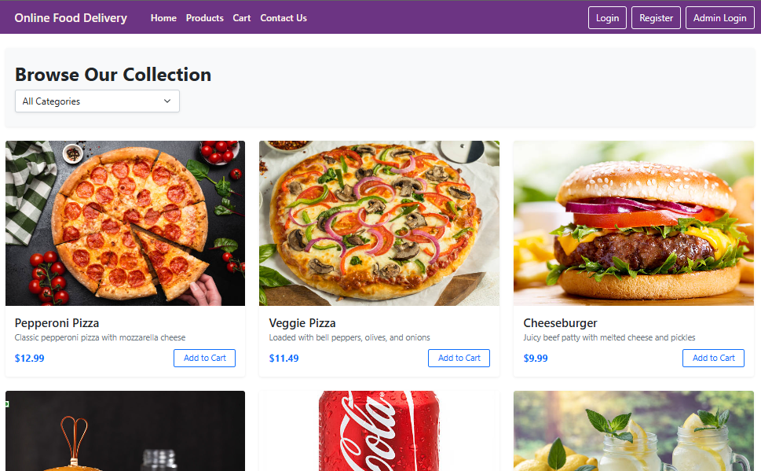
Menu Browsing
The Product Page features a dropdown menu that allows users to select their preferred food category (e.g., Pizza, Burger, Desserts). Based on the selected category, the page dynamically displays relevant products in a grid layout, each with an image and a clear presentation.
Each product card includes an "Add to Cart" button. When clicked, the selected item is added to the cart, and the user is redirected to the Cart Page to review their order.
This setup ensures a smooth and intuitive shopping experience, making it easy for users to browse, select, and proceed with their food orders.

Slide 8
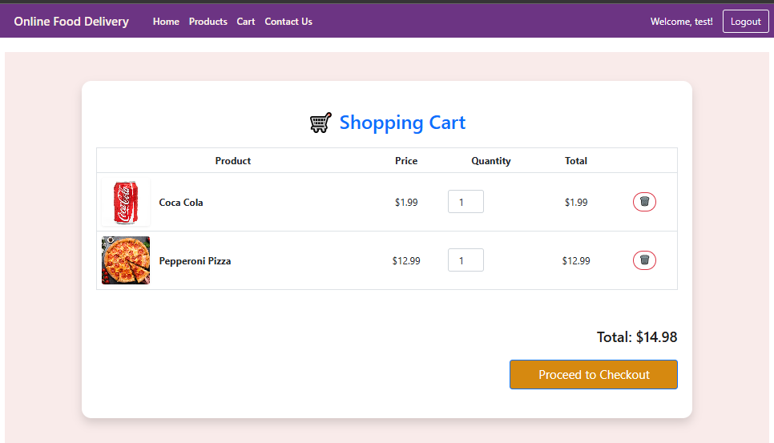
Food Cart Page
The Cart Page displays all the products added by the user, along with their images, names, prices, and quantities. Users can easily increase or decrease the quantity of each item or remove items from the cart as needed.
The page also includes a prominent "Proceed to Checkout" button. When clicked, it redirects the user to the Checkout Page to complete their order.
This functionality ensures users have full control over their cart before placing the final order, enhancing the overall user experience.

Slide 9
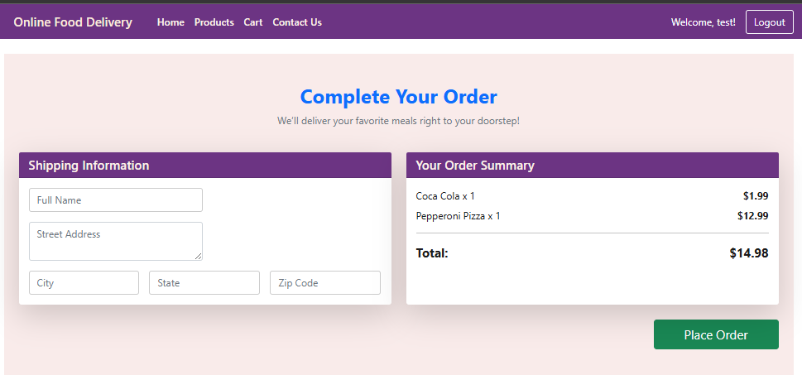
Checkout Page
The Checkout Page collects the user's shipping address details through a structured input form. Alongside the form, the page also displays a clear order summary, including the list of selected products, quantities, and total price.
This final step allows users to review their order and provide accurate delivery information before confirming the purchase, ensuring a smooth and reliable checkout process.

Slide 10
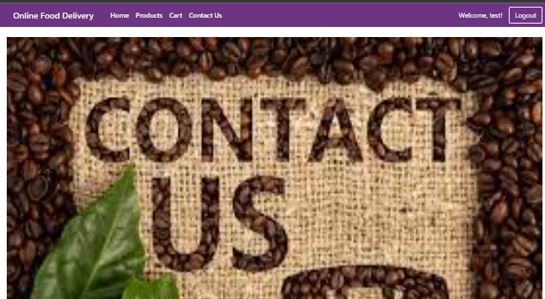
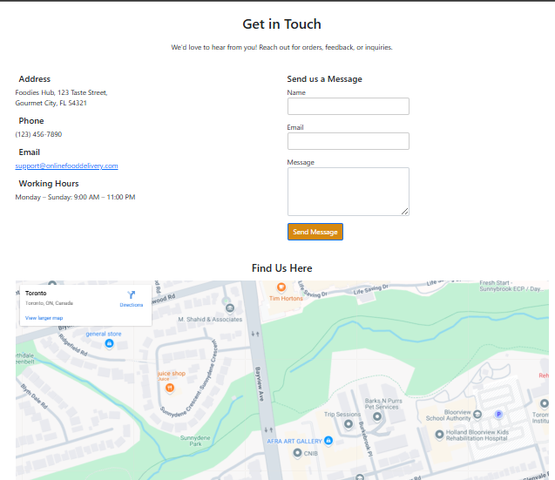
Contact Us Page
The Contact Us Page features a "Get in Touch" section where users can reach out by submitting their email, a message description, and an optional review. This form allows users to share feedback, ask questions, or request assistance.
Below the form, the page displays the exact office location using an embedded map, helping users easily locate and connect with us in person if needed.
This section ensures open communication and builds trust by providing clear contact options and a visible business presence.

Slide 11
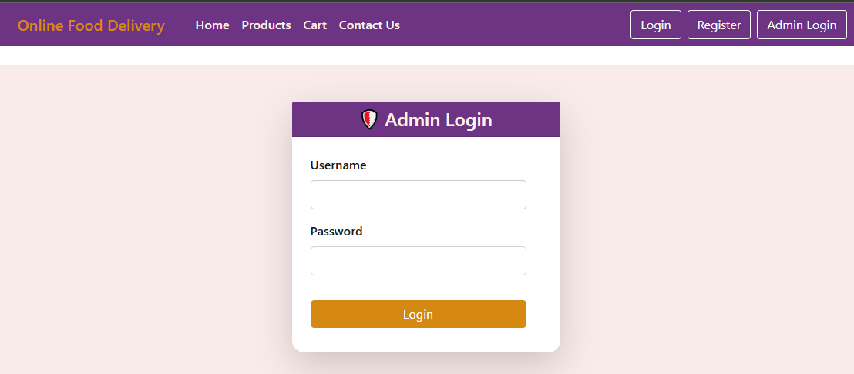
Admin Login Page
We have a dedicated Admin Login Page, separate from the user login. It follows the same login mechanism but is specifically designed for admin users only.
The system includes input validation and verifies whether the entered credentials match an authorized admin account stored in the database. Only valid admin users are granted access to the Admin Dashboard, ensuring secure and restricted access to administrative features.
This ensures that only authenticated admins can manage products, orders, and user data within the platform.

Slide 12
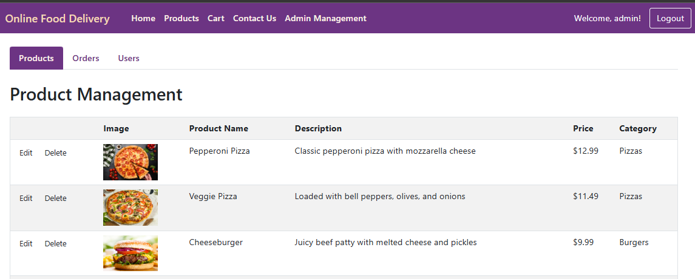
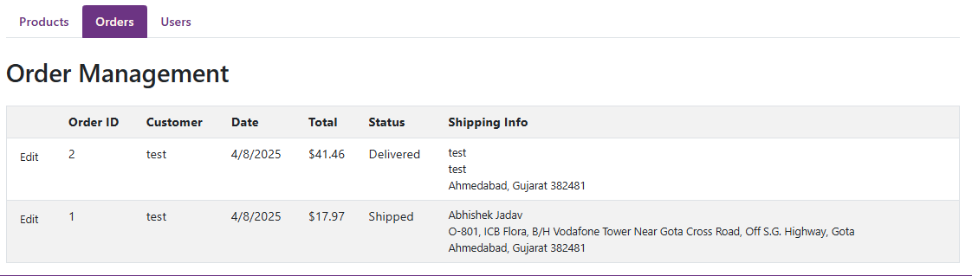
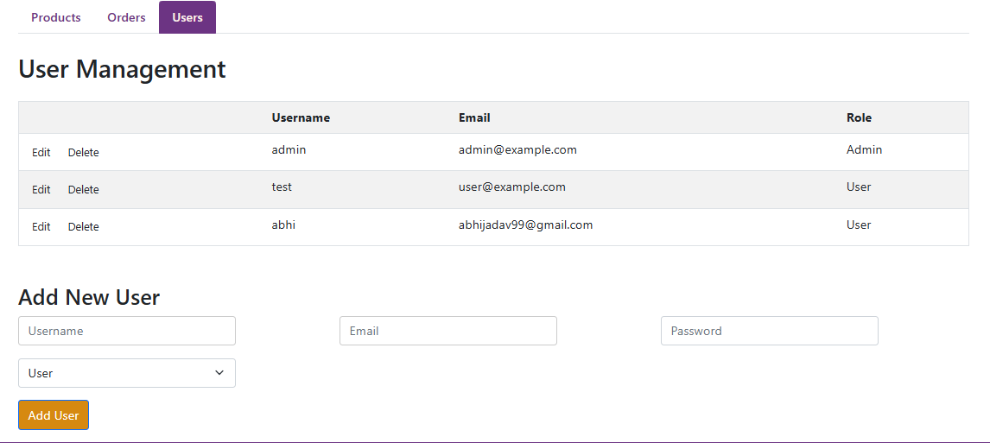
Admin Dashboard Page
The Admin Dashboard provides a centralized interface for managing the platform's core operations. Admins can:
View and manage product details, including the ability to update, edit, or delete existing products.
Access and monitor order details, with the functionality to manually update the order status (e.g., pending, shipped, delivered).
View and manage user details, allowing the admin to oversee user accounts and maintain system integrity.

Slide 13
Future Enhancements
Live Order Tracking: Integrate real-time GPS tracking so users can track their food delivery status live.
Online Payment Integration: Enable secure payment gateways (UPI, Credit/Debit Cards, Wallets) for seamless transactions.
Push Notifications: Notify users of order updates, offers, and promotions in real-time.
Loyalty & Rewards System: Introduce a points-based reward system for frequent customers.
Mobile App Version: Develop a mobile app for Android and iOS to increase accessibility and engagement.

Slide 14
Conclusion
Our Online Food Delivery Website offers a seamless, user-friendly platform for ordering meals quickly and conveniently. From intuitive navigation and personalized product displays to secure login systems and a robust admin dashboard, the system is designed to ensure a smooth experience for both users and administrators.
With features like real-time cart management, dynamic product filtering, and secure order processing, our platform simplifies food ordering and enhances customer satisfaction.

